Slide 1
Prediction of COVID-19 diagnosis Based on symptoms Data Mining Midterm Project
第四組
M104020042 陳亞琦
M104020052 張孫杰

Slide 2
目錄
01
02
文獻探討
資料前處理
03
模型比較
Literature review
Data Preprocessing
Model Comparison

Slide 3
01
文獻探討
Literature review
Machine learning-based prediction of COVID-19 diagnosis based on symptoms

Slide 4
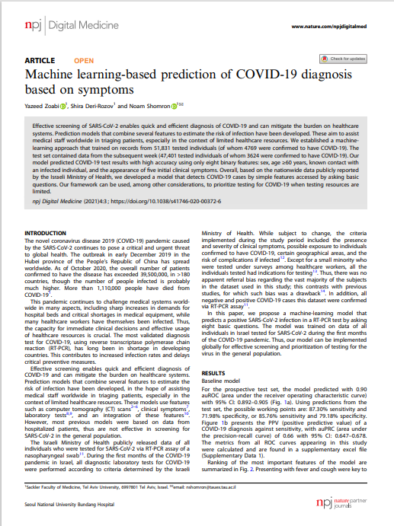
摘要
使用以色列衛生局的公開資料 預測確診Covid-19的機率
在醫療資源有限時 使用特徵篩選Covid-19患者 可有效分配醫療資源

Slide 5
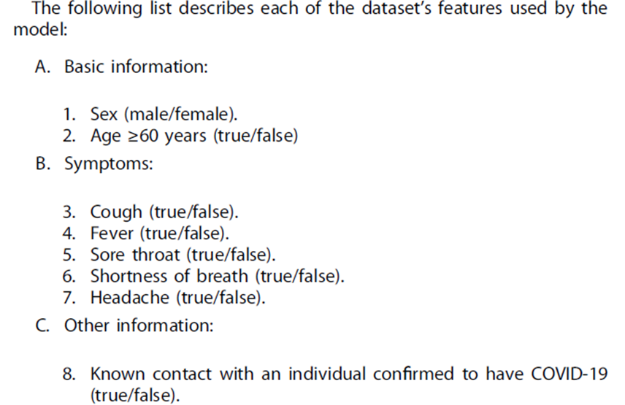
資料集
資料來源
以色列衛生局公開資料
訓練集
本週51,831筆快篩資料 (4769筆確診)
測試集
下週47,401筆快篩資料(3624筆確診)

Slide 6
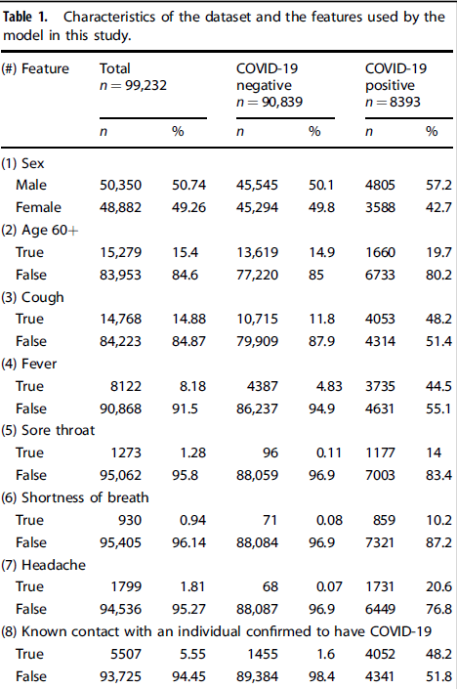
資料集
包含偏差資料
不詳細的資料
資料記載問題
(5) Sore throat
(6) Shortness of breath
(7) Headache
(8) Known contact with a person confirmed to have COVID-19
患者自我回報的資料
沒有紀錄Covid-19的其他明顯症狀

Slide 7
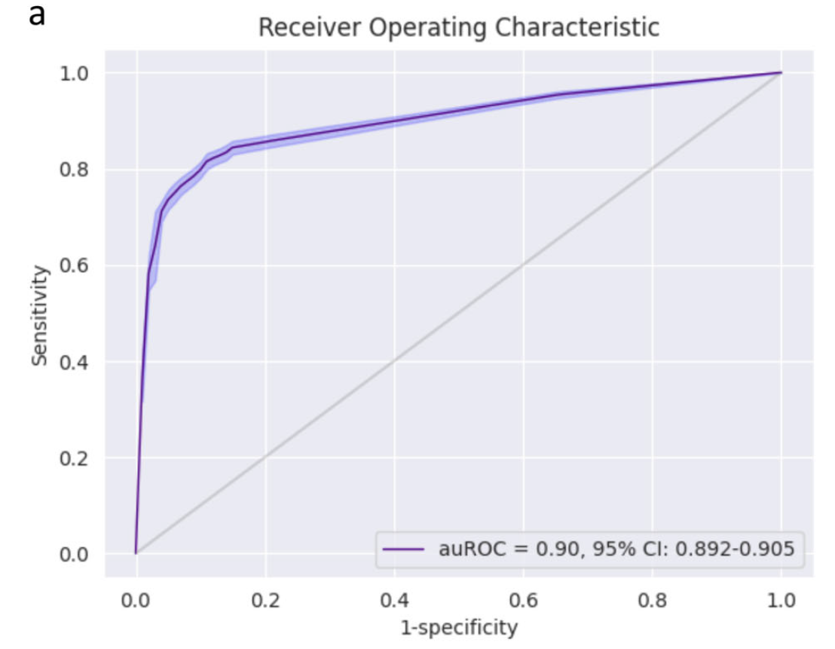
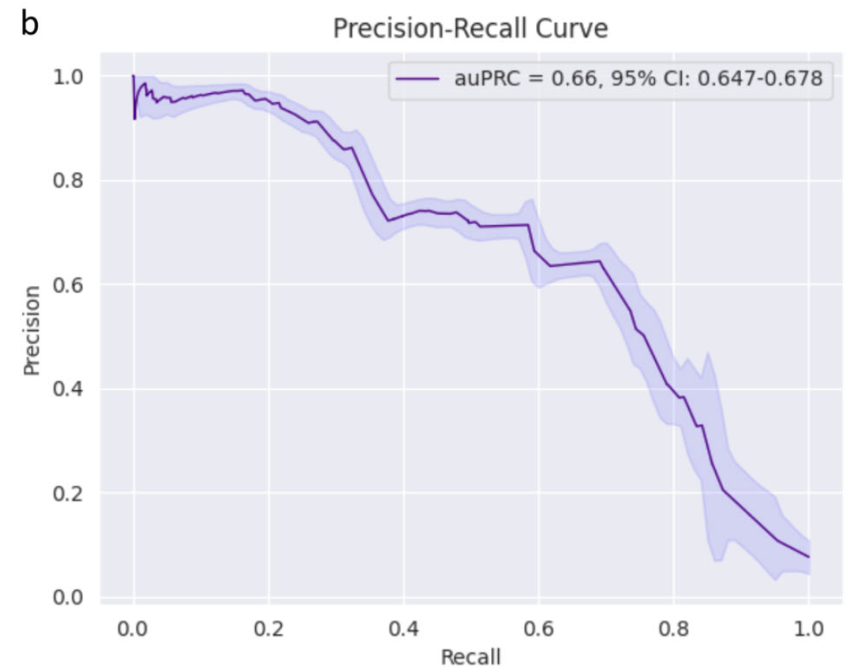
論文模型預測結果(bias)
Model | auROC | TPR | TNR
Gradient boosting(bias) | 0.90 | 87.30% | 71.98%

Slide 8
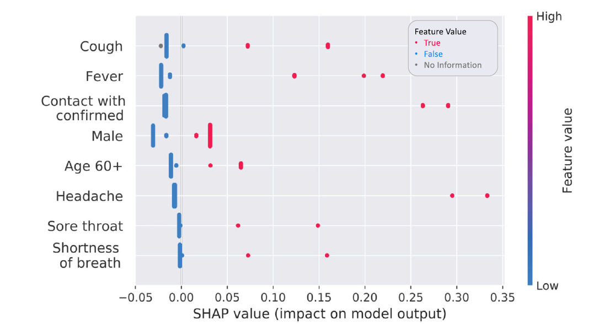
SHAP Value(bias)

Slide 9
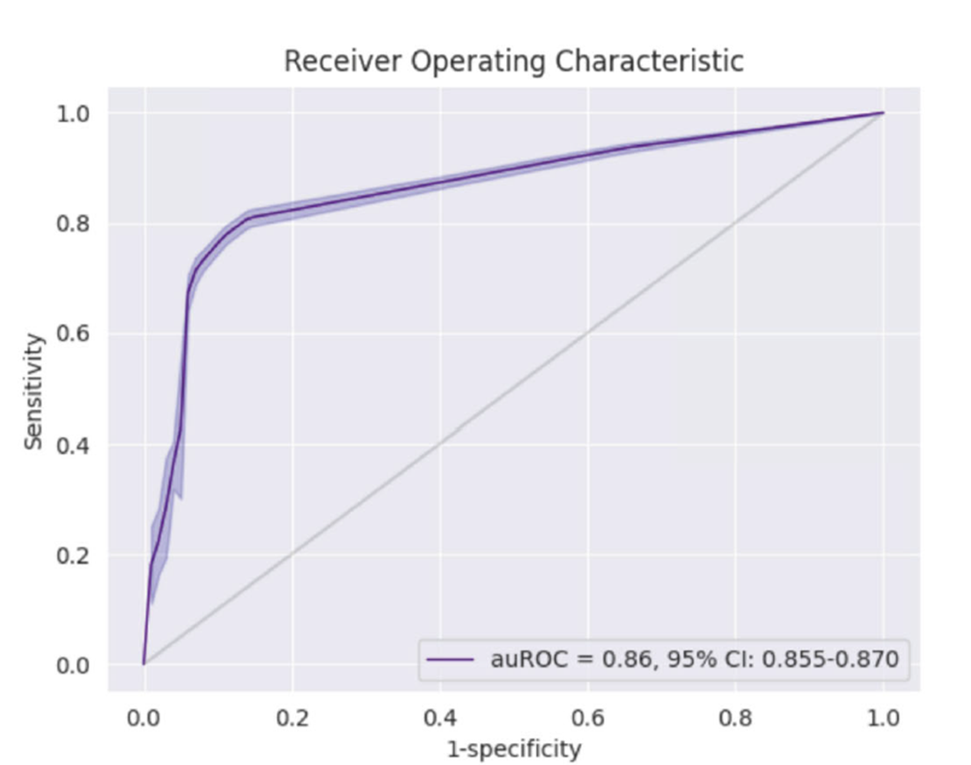
論文模型預測結果
Model | auROC
Gradient boosting | 0.862

Slide 10
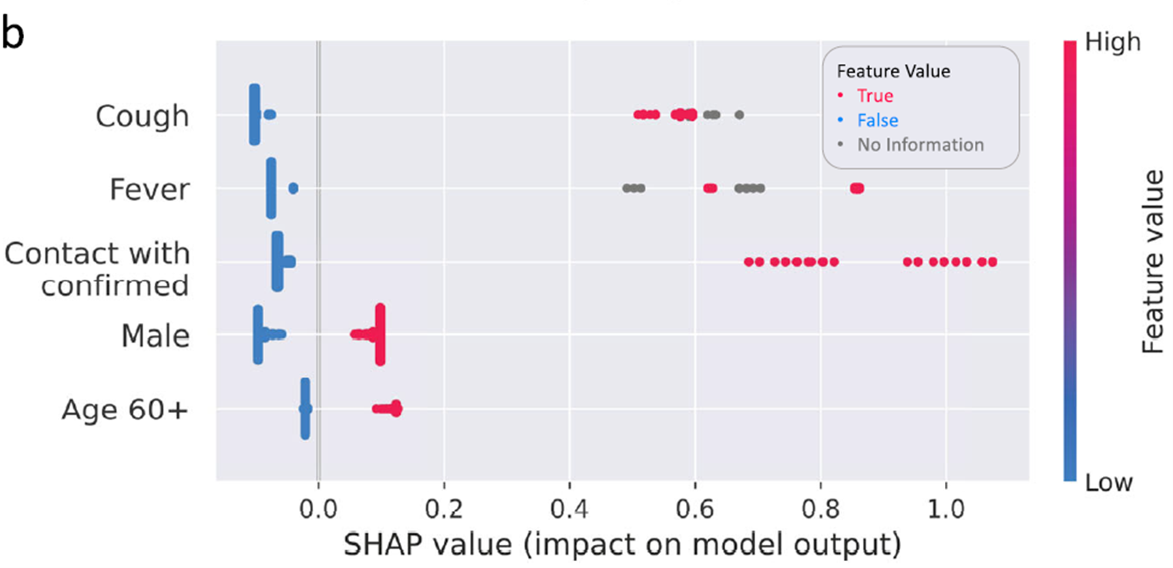
SHAP Value

Slide 11
使用隨機測試集測試模型
資料集
auROC
0.88 0.87
10% Random / 20% Random
移除結果值 (是否確診)

Slide 12
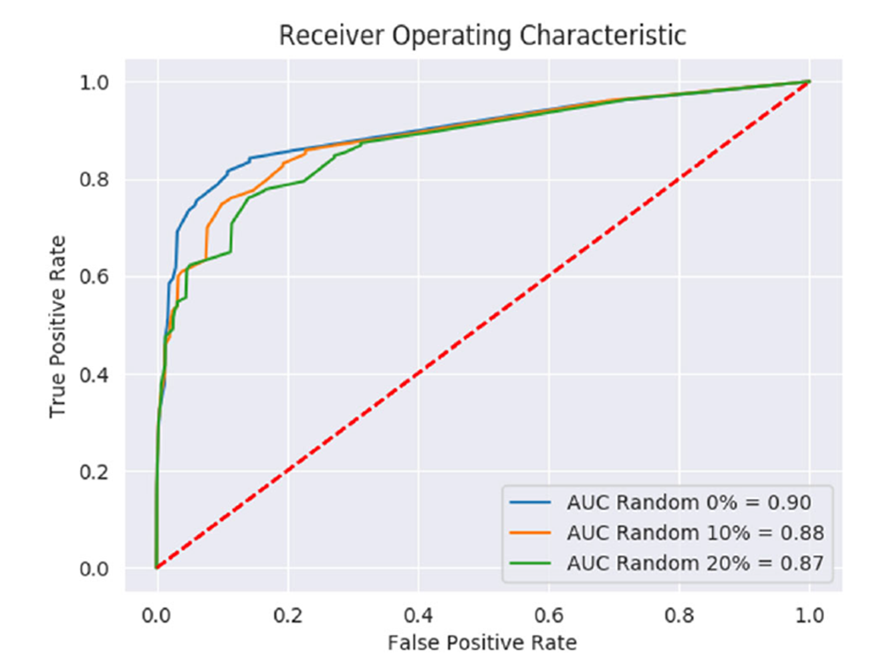
使用隨機測試集測試模型
Original Test set：藍色線
10% Random：橘色線
20% Random：綠色線

Slide 13
02
資料前處理
Data Preprocessing

Slide 14
共有 278848 筆資料
corona_result (Class)
negative | 260227
positive | 14729
other | 3892

Slide 15
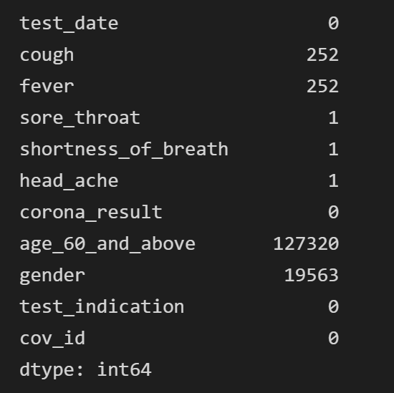
Data Preprocssing
age_60_and_above 的空值將近 50%，欄位為 0 或 1，以 random 填空值
其他的空值以 ‘ffill’，前一個填入

Slide 16
Training set & Testing set
比照 paper，切分成 4:1
分成兩類data
All features
[cough’, ‘fever’, ‘sore_throat’, ‘shortness_of_breath’, ‘age_60_and_above’, ‘gender’, test_indication]
Filtered features
[‘cough’, ‘fever’, ‘age_60_and_above’, ‘gender’, test_indication]

Slide 17
03
模型比較
Model Comparison
Gradient boosting & Decision tree & Random forest

Slide 18
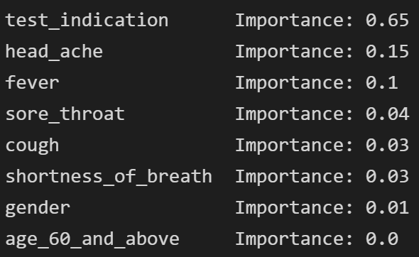
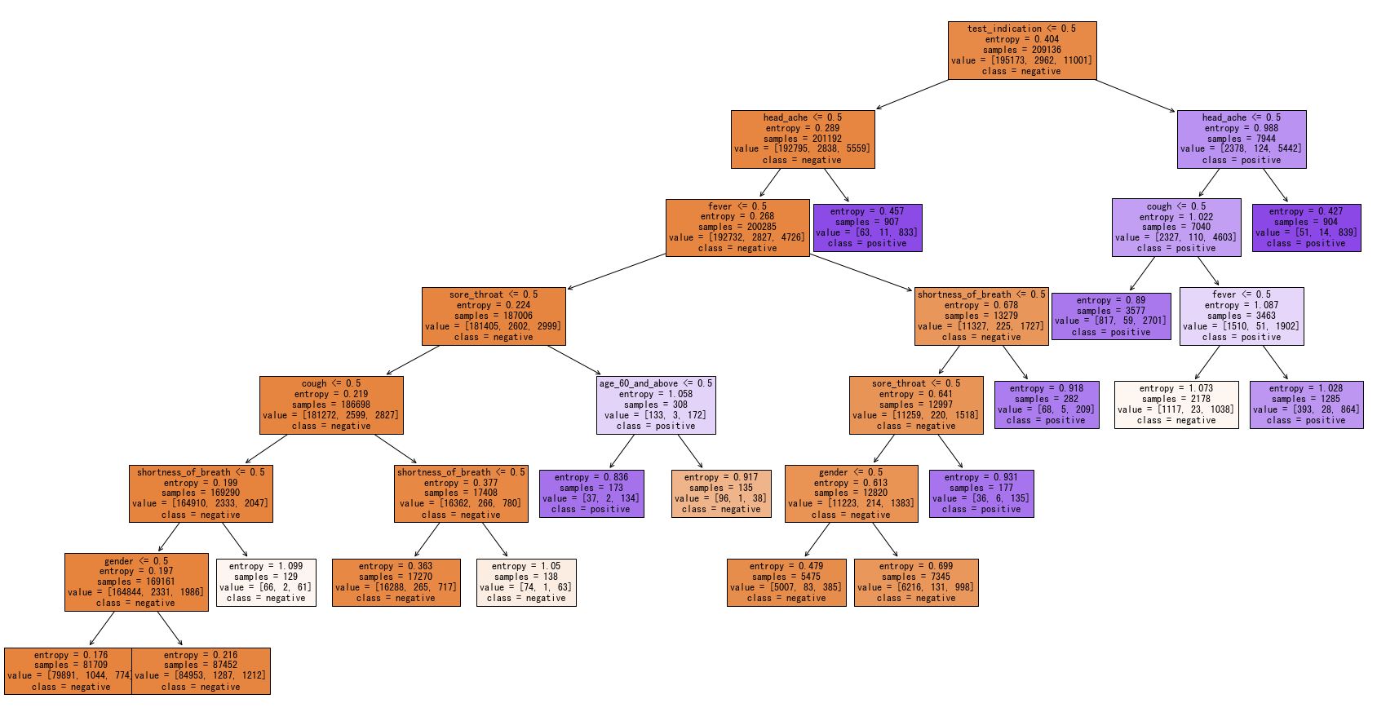
Decision tree (all)

Slide 19
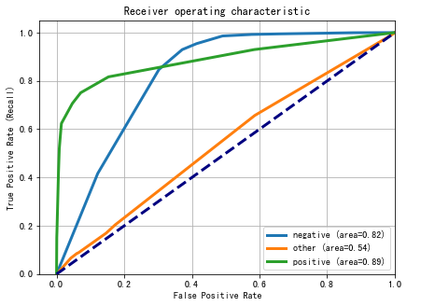
Decision tree (all)

Slide 20
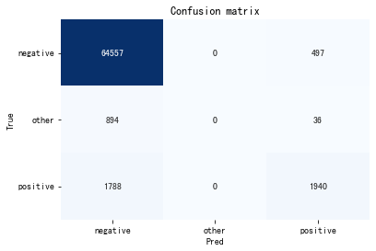
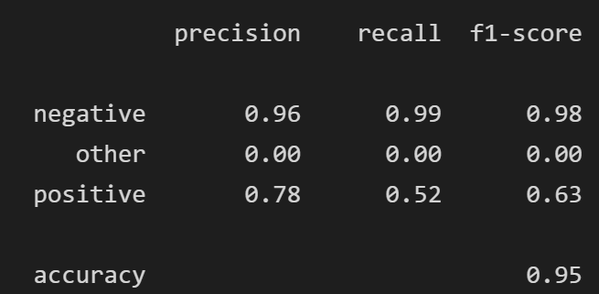
Decision tree (all)

Slide 21
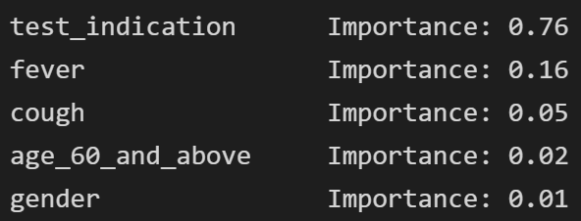
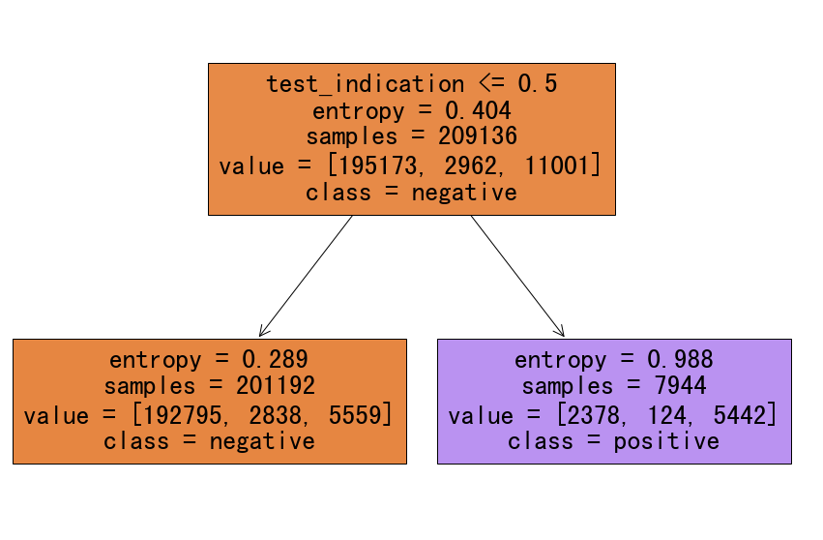
Decision tree (filtered)

Slide 22
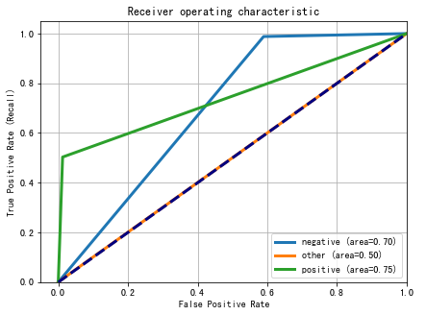
Decision tree (filtered)

Slide 23
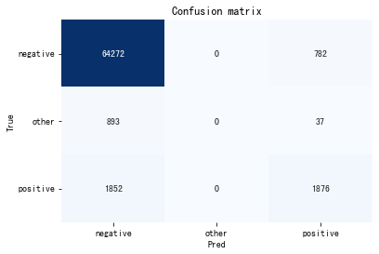
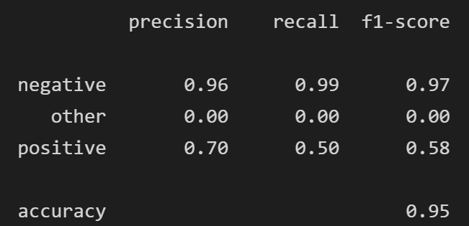
Decision tree (filtered)

Slide 24
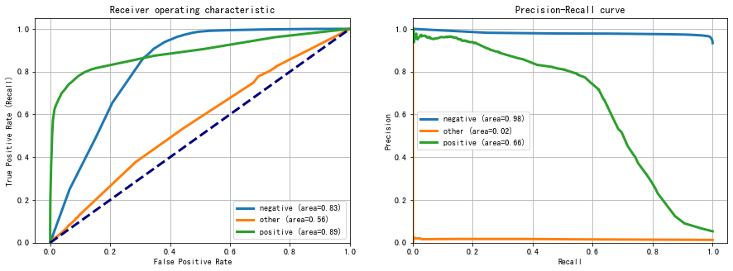
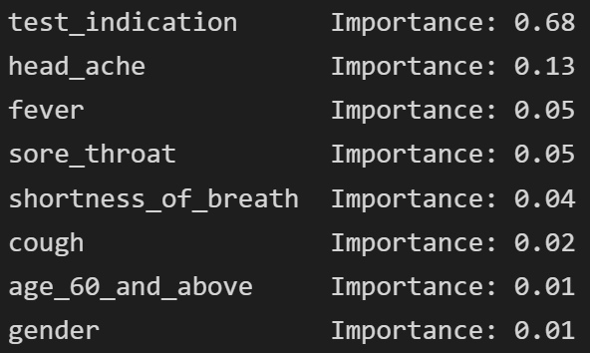
Gradient boosting (all)

Slide 25
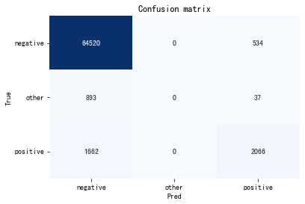
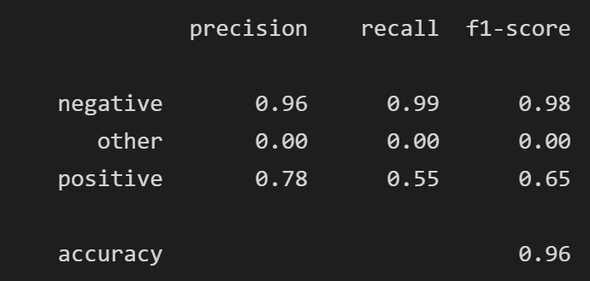
Gradient boosting (all)

Slide 26
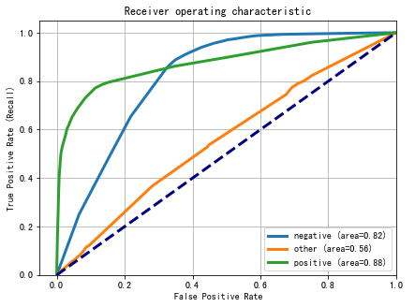
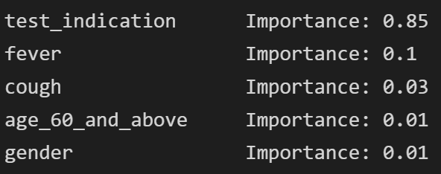
Gradient boosting (filtered)

Slide 27
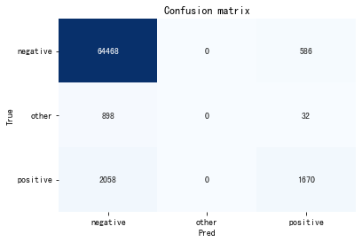
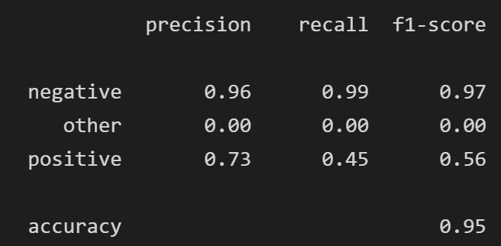
Gradient boosting (filtered)

Slide 28
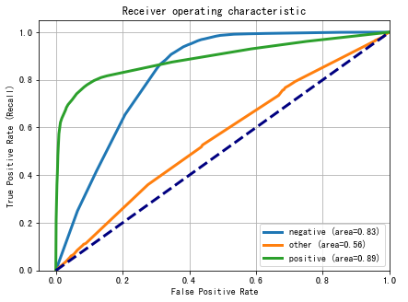
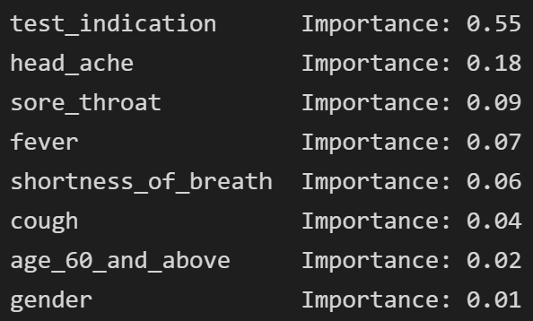
Random forest (all)

Slide 29

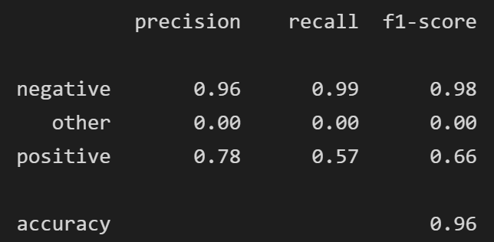
Random forest (all)

Slide 30
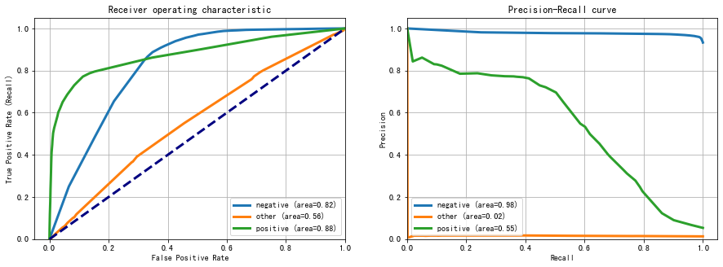
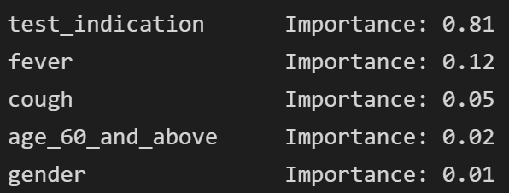
Random forest (filtered)

Slide 31

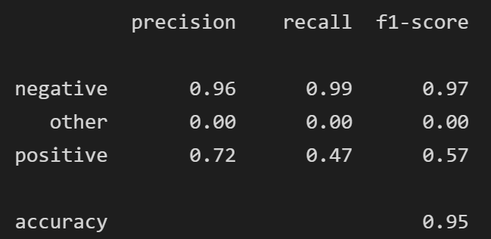
Random forest (filtered)

Slide 32
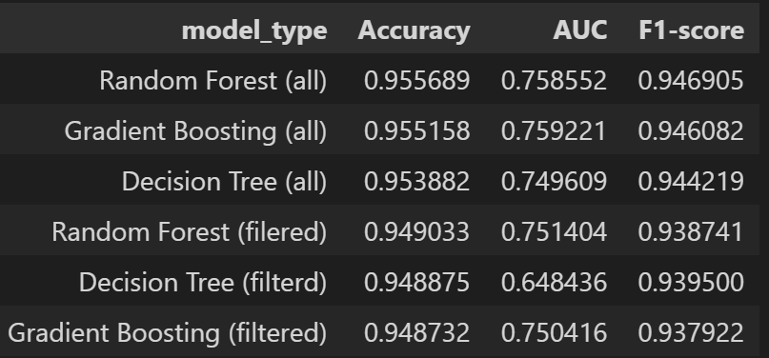
Comparison
auc (positive) | Model
0.89 | Decision tree (all)
0.89 | Random forest (all)
0.89 | Gradient boosting (all)
0.88 | Random forest (filtered)
0.75 | Decision tree (filtered)
0.88 | Gradient boosting (filtered)
0.9 | paper(all)
0.862 | paper(filtered)

Slide 33
Comparison
auc (positive) | Model
0.89 | Decision tree (all)
0.89 | Random forest (all)
0.89 | Gradient boosting (all)
0.88 | Random forest (filtered)
0.75 | Decision tree (filtered)
0.88 | Gradient boosting (filtered)
0.9 | paper(all)
0.862 | paper(filtered)

Slide 34
Thank you

